Slide 1
Suppose you have to find the distance from point A to point B
… and there is a slimy alligator
in that pond.
… and there is a slimy pond in
your way
A
Excuse me?
B

Slide 2
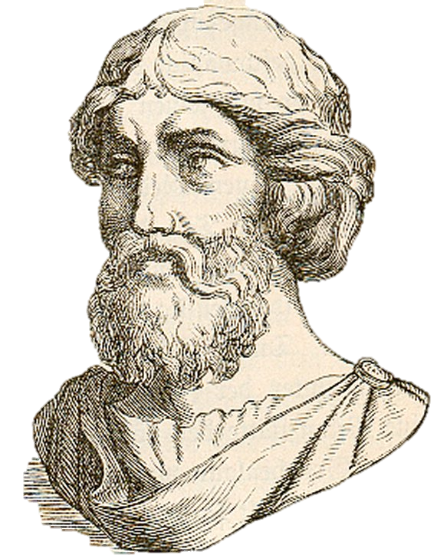
Without getting your feet wet
-- or nibbled on --
you can measure the distance
with two little things.
A measuring stick.
And this Greek
guy’s theory.

Slide 3
Then measure
east to point B.
Start by measuring
south from point A.
A
Three units
Seven units
B

Slide 4
This is where the
Greek dude comes in.
His name is Pythagoras, and his
theorem states that in a
right triangle, the sum
of the squares of the
shorter legs is equal
to the square of the
hypotenuse.

Slide 5
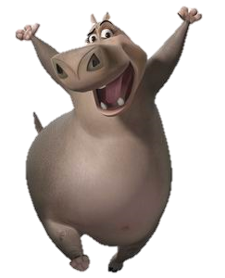
Say what?
Square the length of each leg.
Then add 9 + 49 and get 58.
-- the hypotenuse.
The square root of 58 is the
length of the longest side
3² = 9 and 7² = 49
Did you
say hippo?
A
$$\sqrt{58}$$
It’s
easy.
B

Slide 6
The Pythagorean Theorem
is represented by
a² + b² = c²
with the shorter legs of the
right triangle being ‘a’
and ‘b’ and the
hypotenuse
being ‘c’.
c
b
a

Slide 7
So how far is it from
point A to point B?
A
Get a
calcu-gator
B

Slide 8
Press 2ND
7.07 units
Then
$$x^{2}$$
With the
above it.
Then 58.
$$\sqrt{58}$$

