Slide 1
King Alfred IX intends to celebrate his 75th birthday by riding a zip line from
the top of his castle’s tallest tower to a target
on the ground in the center of his royal subjects.

Slide 2
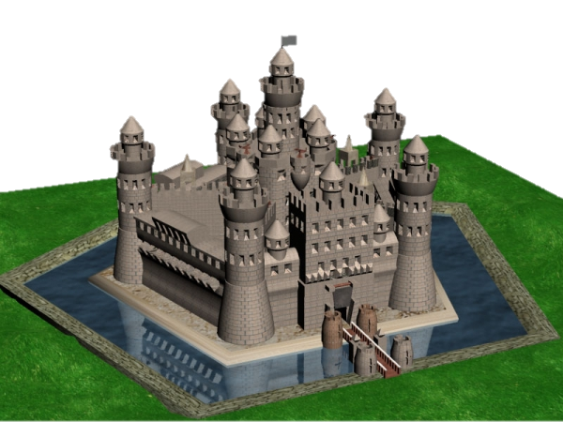
tallest tower
target

Slide 3
The Royal Engineers, however, have quickly discovered a problem.
The apartments containing King Alfie’s 14 daughters are located in the middle
of the flight path.

Slide 4
desired
flight path
daughters’
apartments

Slide 5
King Alfie is disappointed the target can not be in front of the drawbridge,
but he asks his trusted engineers for an alternative. They
propose this:

Slide 6
new
flight path
80 yards

Slide 7
The new landing area is
80 yards to the right of
the original. The Royal Engineers’ next task is
to find the length of the zip line on which King Alfie will descend on his big day.

Slide 8
One of them says, “too bad he isn’t landing in front of the castle, we could have used a² + b² = c². It’s called the Pythagorean Theorem. Look at the measures of
a and b.”

Slide 9
28 yards
54 yards

Slide 10
A second one says,
“we know three measures, we can find the fourth by using a² + b² + c² = d². Observe the lines in this very room in which we sit.”

Slide 11
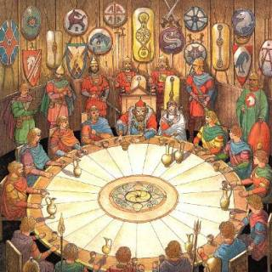
c
d
b
a

Slide 12
Use these measurements to find the length of the
zip line:
Landing area to front of castle: 80 yards
Front to center: 54 yards
Floor to tower: 28 yards

