Slide 1
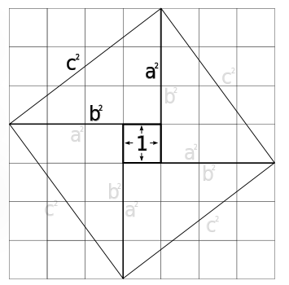
Let’s prove the Pythagorean Theorem
Twice!

Slide 2
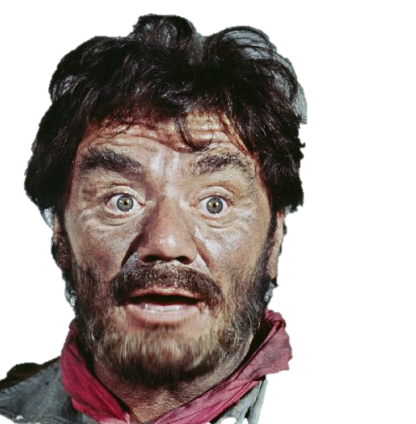
Let’s make a rectangle
F I N D
out of one inch squares
T H E
by 3
high
A R E A
4 wide
Seriously, kid. What’s the area?
Okay.
Why dincha
say so?
12?

Slide 3
Add the
center to
get 25.
So four of these would
have an area of 24.
Let’s divide our
rectangle in half.
What is the area now?
Six, right?

Slide 4
Since this square has
an area of 25, each side
equals 5.
So each
triangle
has side
lengths
of 3-4-5.

Slide 5
3-4-5 triangles are
the most famous Pythagorean Triples.
3² + 4² = 5²
9 + 16 = 25

Slide 6
25
5²
5
9
3
3²
4²
4
16

