Slide 1
Scientific Notation
a x 10^{b}
^{1<a<10}

Slide 2
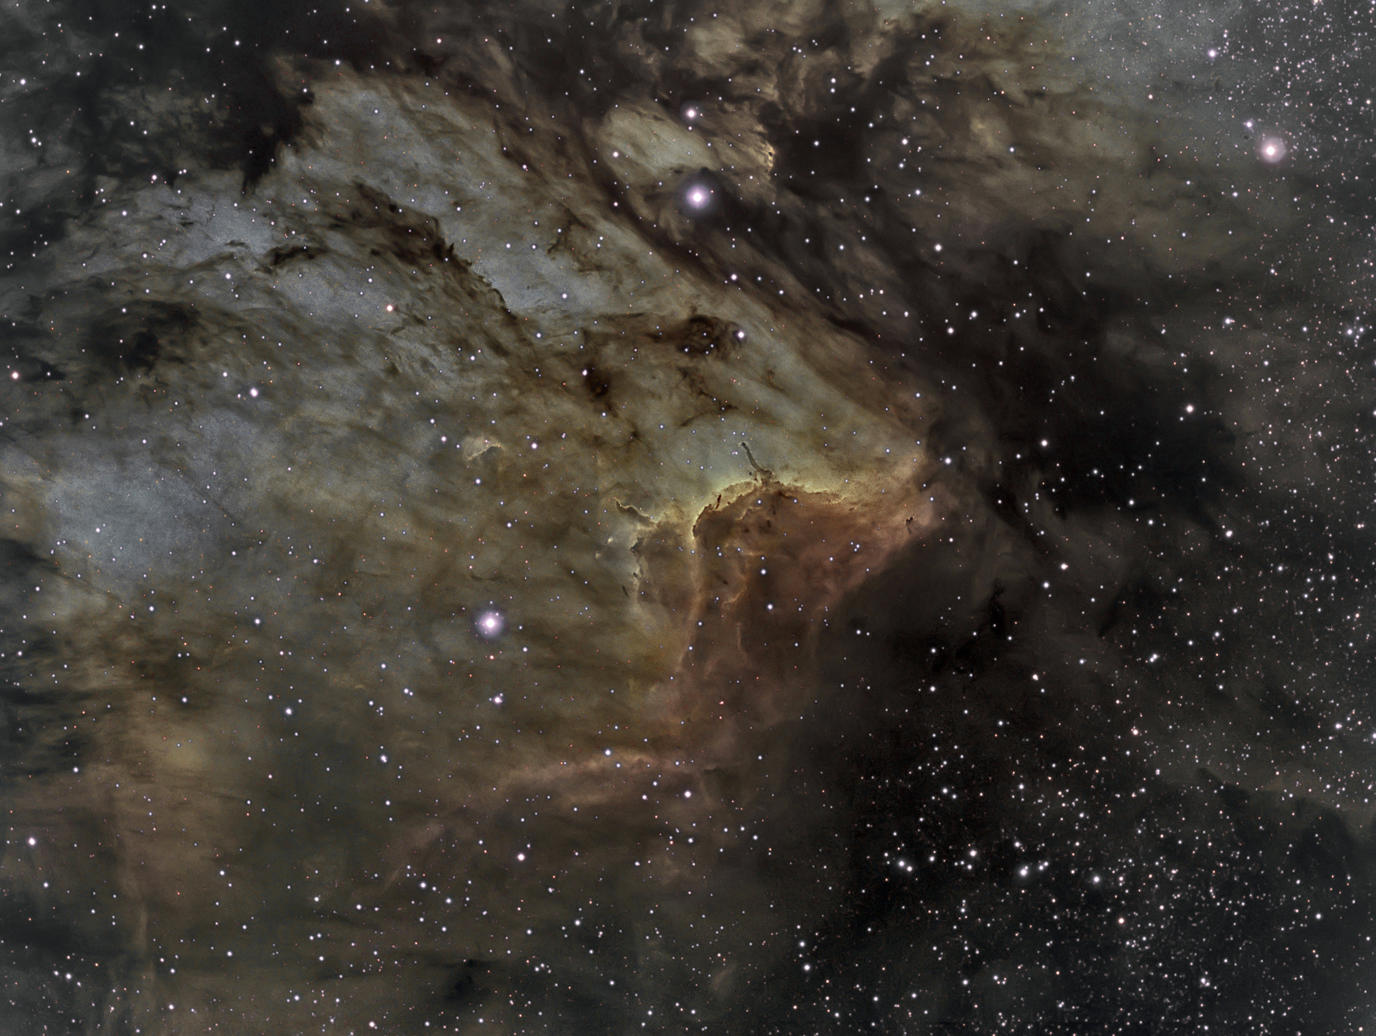
The Pelican Nebula is 10,600,000,000,000,000 miles away. Write this in Scientific Notation.

Slide 3
1.06 x 10¹⁶

Slide 4
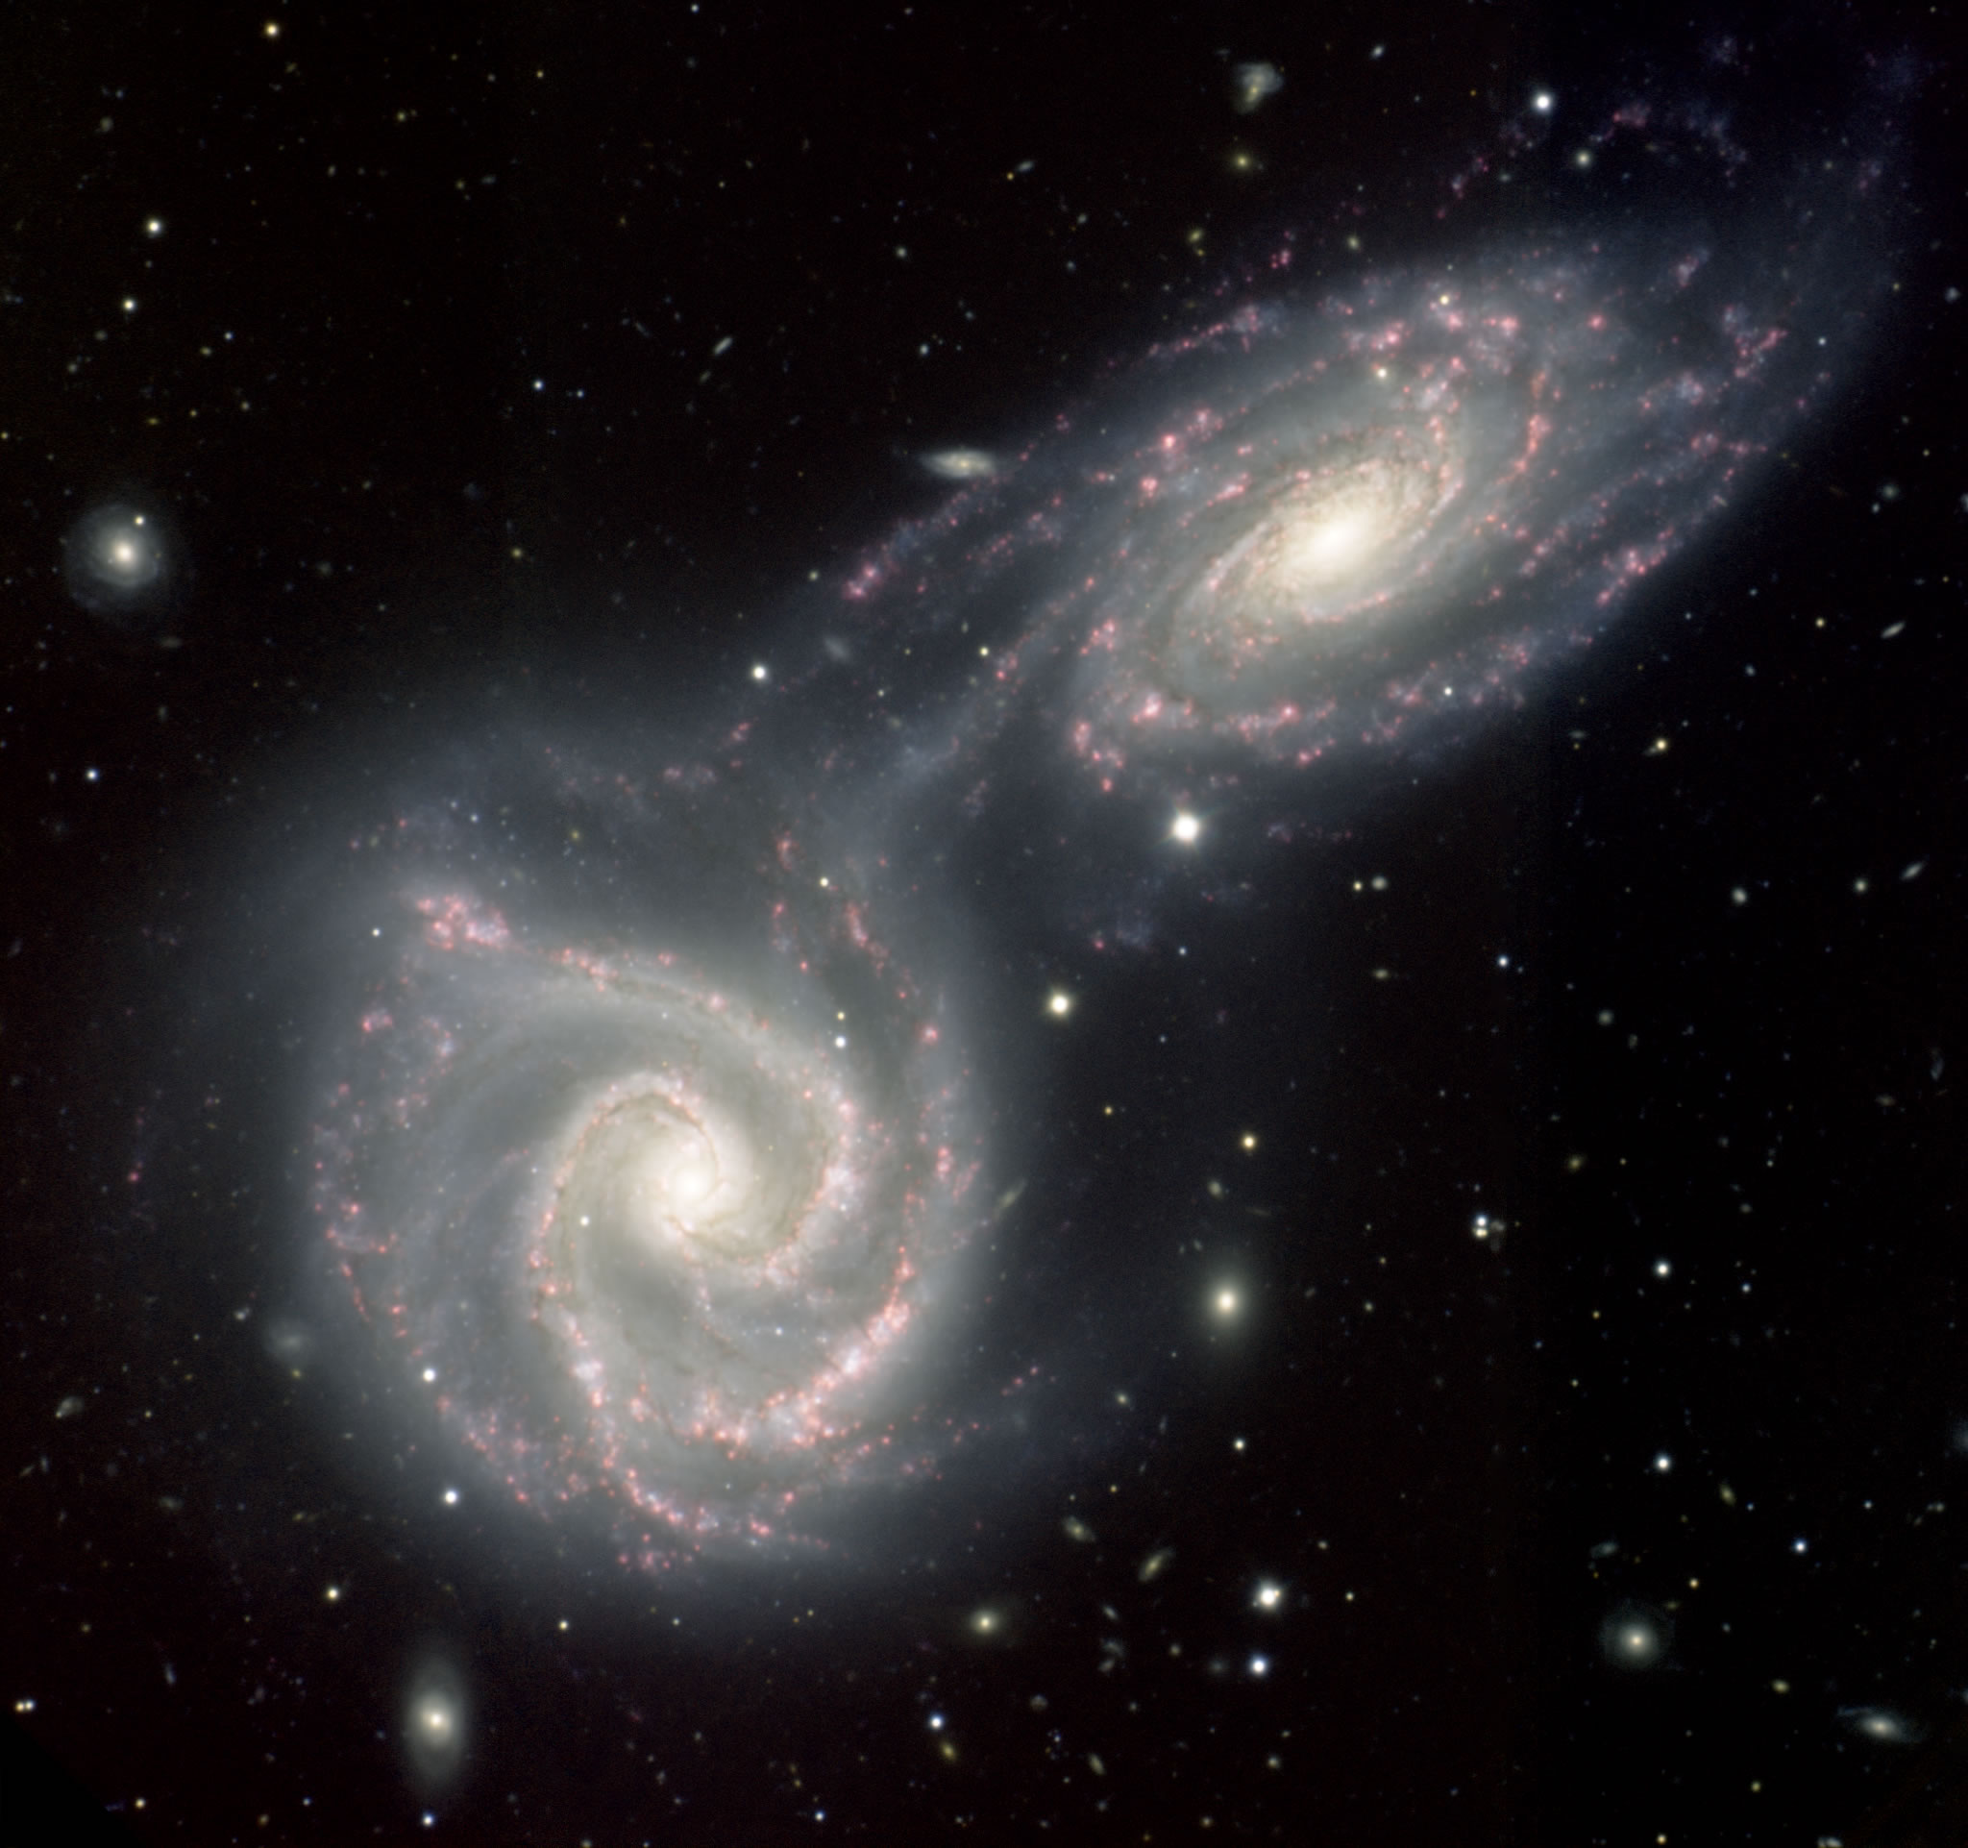
These Colliding Spiral Galaxies are 130,000 light years away. SN?

Slide 5
1.3 x 10⁵

Slide 6
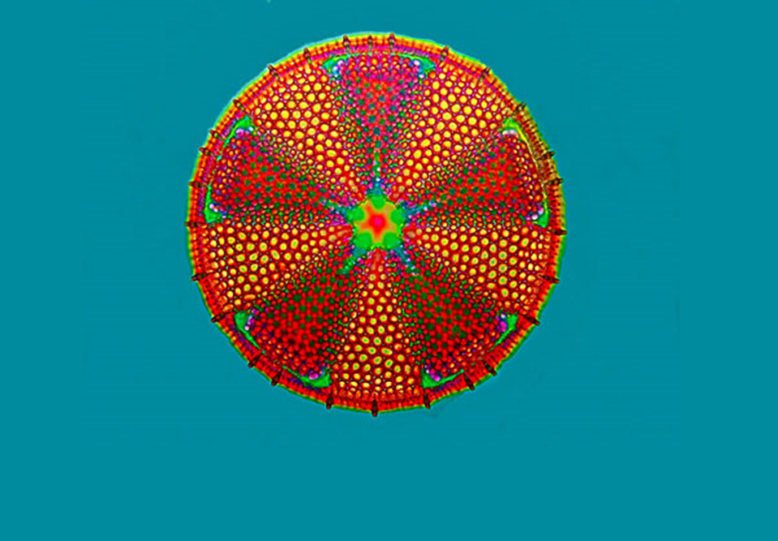
This micrograph magnifies a 20 million-year-old fossil of an extinct breed of algae. Express its age in Scientific Notation.

Slide 7
2.0 x 10⁷

Slide 8
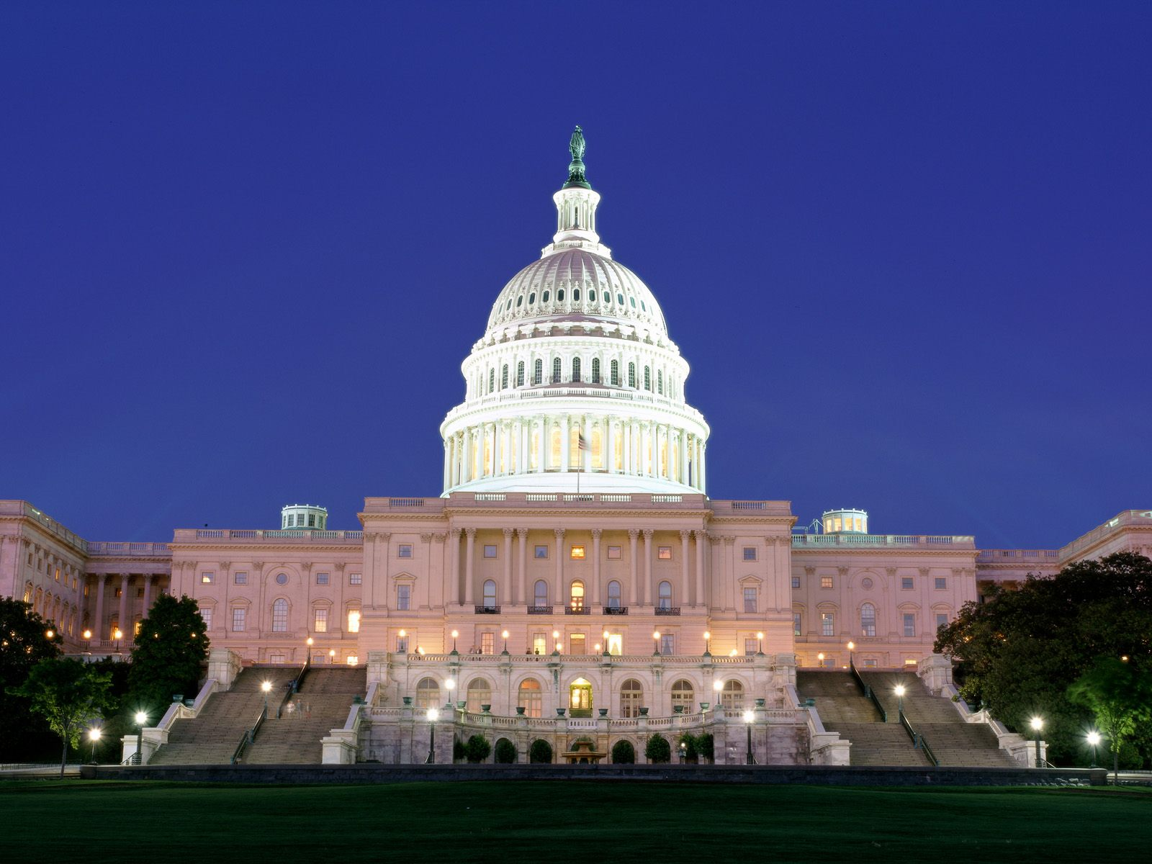
The 2015 federal budget for the United States of America
is over one trillion dollars. Express $1,029,000,000,000
in Scientific Notation.

Slide 9
1.029 x 10¹²

Slide 10
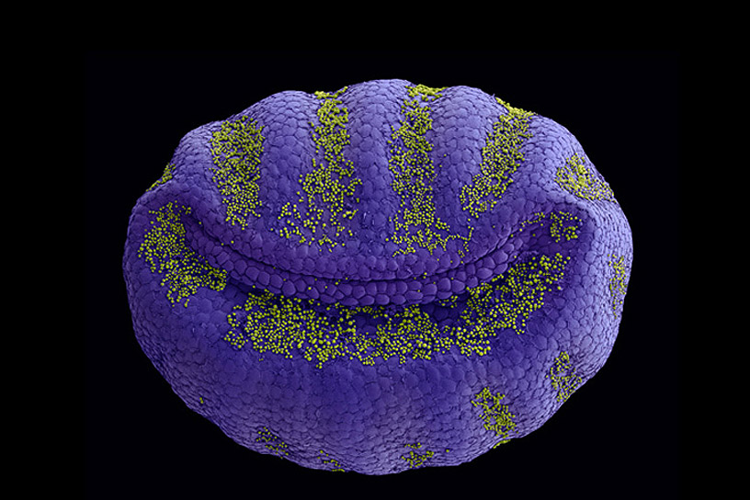
What is the scientific notation for this happy
looking discovery under a microscope which
measures 0.00025 meters across.

Slide 11
2.5 x 10 ⁻⁴

