Slide 1
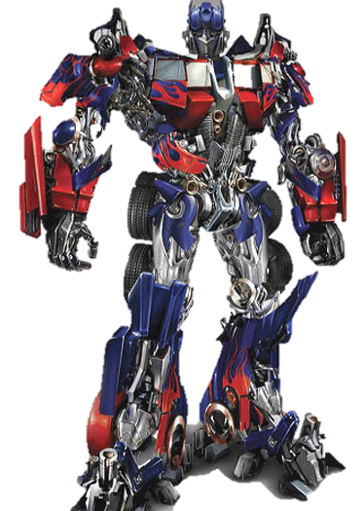
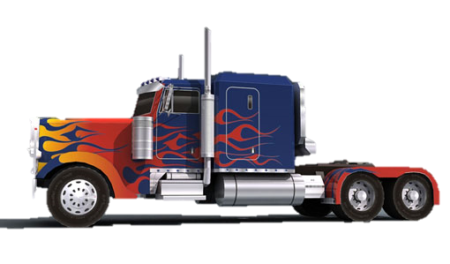
Transform
ers
ations

Slide 2
Reflection:
A transformation in which a point or a figure is flipped across a line to obtain a mirror image.
RE
FL
ECTIONS
FL
IP

Slide 3
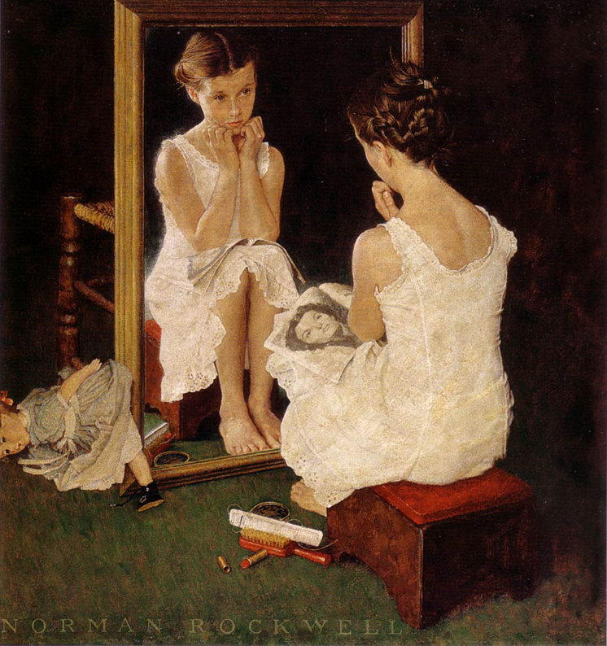
“Girl at Mirror”
Norman Rockwell
The Saturday
Evening Post
March 6, 1954

Slide 4
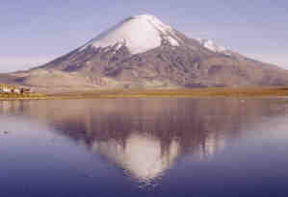
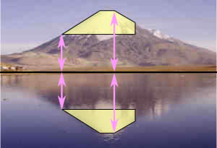
In both Norman Rockwell’s painting and in the photos above, certain truths are apparent about reflections.
Every point is the same distance from the central line.
and
The reflection is the same size as the original image.

Slide 5
The central line is called the “line of reflection.”
Our experience has been to reflect across the x-axis…
… or across the y-axis.

Slide 6
We can reflect across the line x = 3...
But we are not limited to reflecting across the axes.
… or y = –2.

Slide 7
We could even reflect across a diagonal line...
…like y = x.

Slide 8
Translation:
A transformation where every point moves the same distance in one or two directions within the plane.
SL
TRAN
SL
ATIONS
IDE

Slide 9
They never change size, shape or direction. The image is congruent to
the original figure.
Figures can be translated left or right…
Then up or down.

Slide 10
Rotation:
A transformation obtained by rotating (turning) a figure around
a fixed point.
RO
T
T
ATIONS
URN

Slide 11
You look like
You’re plotting something

Slide 12
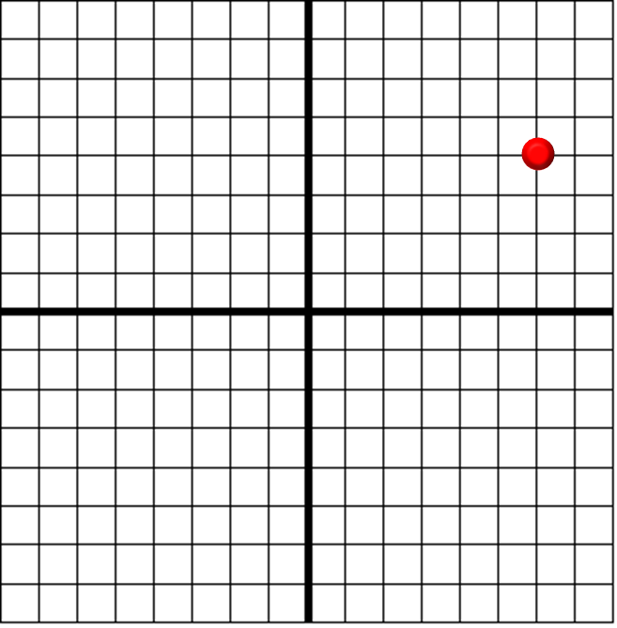
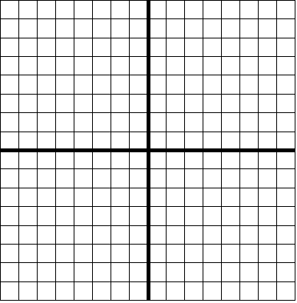
A
R
O
T
A
T
I
O
N
I
A
M
(6,
4)

Slide 13
Dilation:
A transformation which produces
a figure similar
to the original by proportionally stretching or shrinking the
figure.
DILATIONS

Slide 14
The scale factor, or scalar factor, measures how much larger or smaller the image is. A scale factor of 2 means the image is twice as large as the pre-image.

Slide 15
A scale factor of $\frac{1}{3}$ means the image is one-third as
large as the pre-image.

Slide 16
We can even dilate a point by moving it further from,
or closer to, the origin.
Scale Factor: 1.5
A’: (6, 3)
A: (4, 2)
B’: (1, 1)
B: (4, 4)
Scale Factor: .25

Slide 17
Which is the only transformation whose image is not congruent to
its pre-image?
A Reflection
B Translation
C Rotation
D Dilation

